Slide 1
Indonesia Digital University
Senin, 19 Agustus 2019 Rapat Kerja Daerah (Rakerda) LLDIKTI Wilayah 4
LLDIKTI Wilayah 4
Prof. Dr. Adiwijaya Telkom University

Slide 2
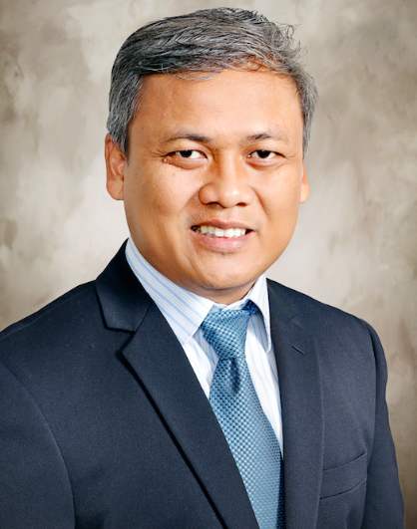
Brief Curriculum Vitae
Name : Adiwijaya
NIDN : 0421097401
P/D of birth : Majalengka, 21 September 1974
Email : adiwijaya@telkomuniversity.ac.id
Phone : +62 822 176 33 999
Blog : adiwijaya.staff.telkomuniversity.ac.id
 | as Lecturer and researcher (since 2000)
 | as Professor at School of Computing, Telkom Univ. (2016)
Activities
as a Vice Dean (2014-2017)
as a Director of BTP (2017-2018)
as a President (2018-now)
as Assessor of BAN PT (2015-now)
Achievements
2,5 Billion IDR of Research Grants and Publication
13 Intellectual Property
115 Documents
H-index = 11
Citation = 637
H-index = 13

Slide 3
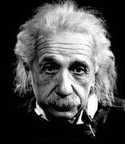
“If I had an hour to solve a problem I'd spend 55 minutes thinking about the problem and 5 minutes thinking about solutions.” – A. Einstein
“Sebaik-baik manusia adalah yang paling bermanfaat bagi manusia lain” – H.R Ahmad, Thabrani
Albert Einstein Ilmuan
Muhammad SAW
Rasulullah

Slide 5
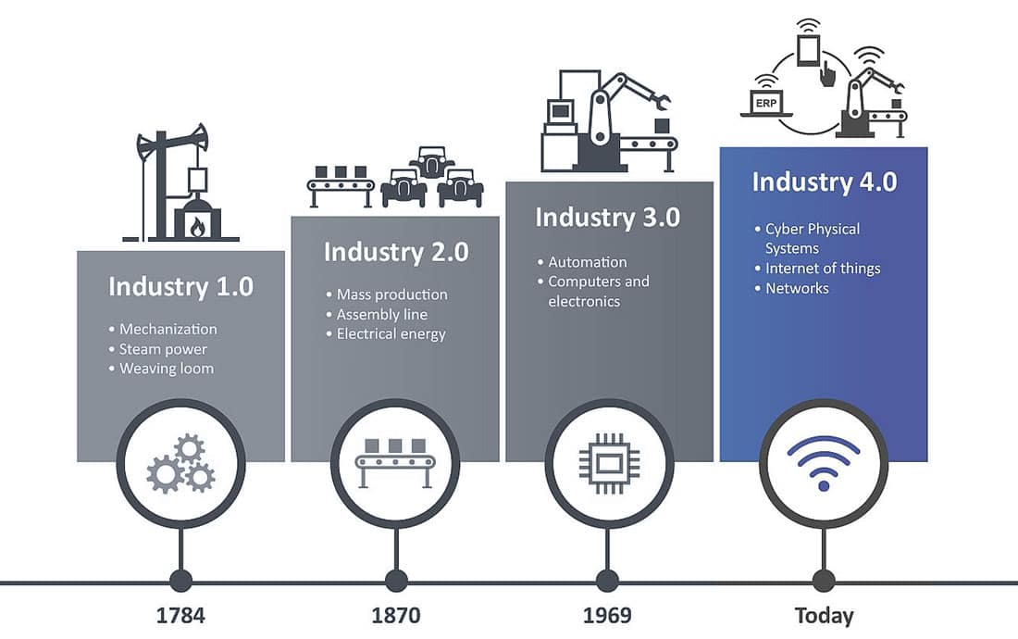
Industry Revolution 4.0

Slide 6
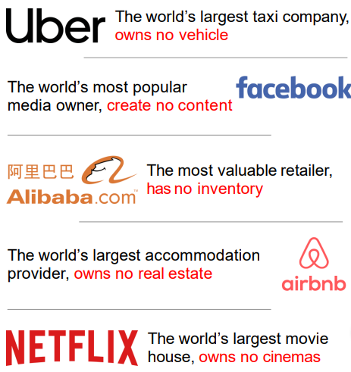
Industri Jaman Now
}
On Demand Services
132,7 Juta Pengguna Internet
415,7 Juta Pengguna Smart Phone
Pangsa Pasar di Indonesia
Financial Technology
E-Commerce
Pangsa Pasar di Indonesia
Potensi transaksi di Indonesia
Proyeksi transaksi di Indonesia 2016
US$ 14,5 Miliar (Rp. 190 Triliun)
2013 US$ 8 miliar (Rp 104 triliun)
2016 US$ 20 miliar (Rp 261 triliun)
Nominal transaksi per populasi 2014 US$ 56,98 miliar (Rp 747 triliun)
2020 US$ 130 miliar (Rp 1.700 triliun)

Slide 7
How To Realizing Society 5.0?

Slide 8
Society vs Technology
Society 5.0 aims to increase the quality of human lives, not to increase the power of technology
Smart service aim to increase the quality of human lives, not to increase the power of technology
A service always involves an interaction of human and possibly non-humans.
We need to understand what human interaction with other humans and non-humans is to understand what smart services is.
Interaction is (equivalent to) the ‘sharing’ of information among participating agents.

Slide 9
Leadership Matrix

Slide 10
How to Improve? Input - Proses - Output - Outcome
Standard Parameter
Bagaimana bisa menjadi PT yang berkualitas?
Culture to Value
Continuous
Quality Improvement

Slide 11
Renstra ➔ Kontrak Manajemen (KM)
Renstra
Sasaran strategis
Program Strategis
RKMA
Faktor Eksternal & Internal
KM
SWOT - TOWS
Sasaran Mutu
Standard Kualitas

Slide 12
Kontrak manajemen (KM)
KM Universitas
KM Unit
Tel-U point
Dosen
Gaji
Fakultas & Direktorat
Universitas

Slide 13
Contoh Kontrak Manajemen

Slide 14
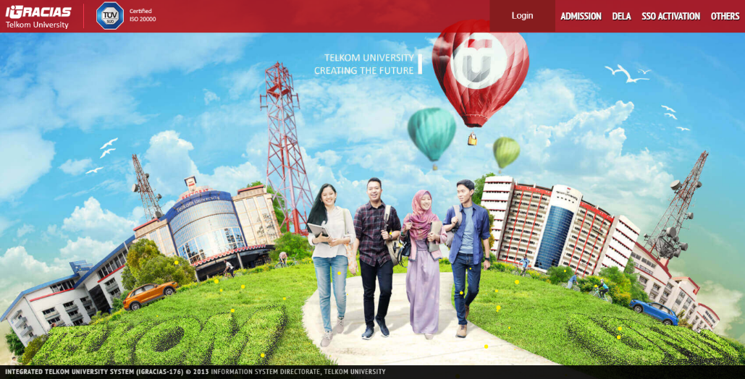
Best Practice - Digital Services
Sistem Layanan Terintegrasi (akademik & non-akademik)
Manajemen infrastruktur jaringan dan layanan sistem informasi terpadu
Integrasi aplikasi pihak ke tiga dengan Single Sign On (Google,Microsoft, dll)
Sistem Smart Building, Smart Attendance dan Smart Parking
Information System

Slide 15
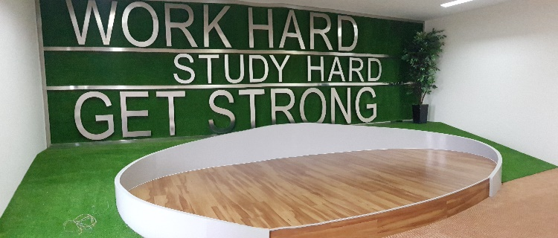
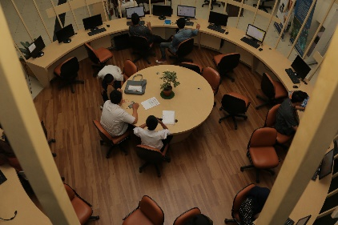
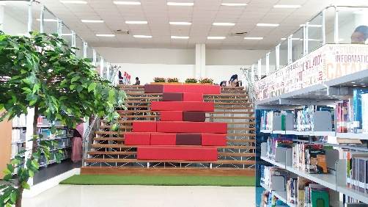
Best Practice - Open Library
Open for any kind of knowledge
Open for sharing catalog and resources with other institutions or platform
Open for everyone who wants to learn and share
Book
Jurnal
Thesis
Magazine
Laporan
Magang
Bahan Ajar
eArticle
Sharing
Catalog
& Resources
OpenLibrary Telkom University
Other Platform
Indonesia One Search
Google Scholar
Other Institution
eBook
eProceeding
Refreshment Corner
Final Project
Teaching Material
CD DVD
Submit
Review
Approval
Publish
with Authentification setting
Open Discussion Room
Digital Service Area
Collection Area

Slide 16
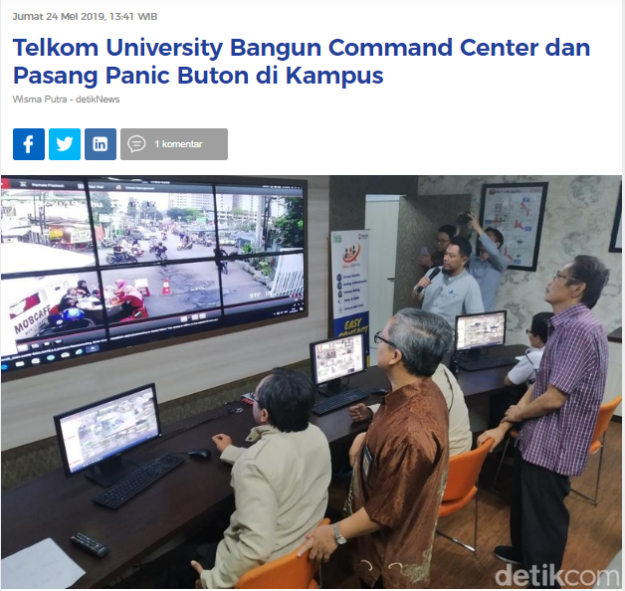
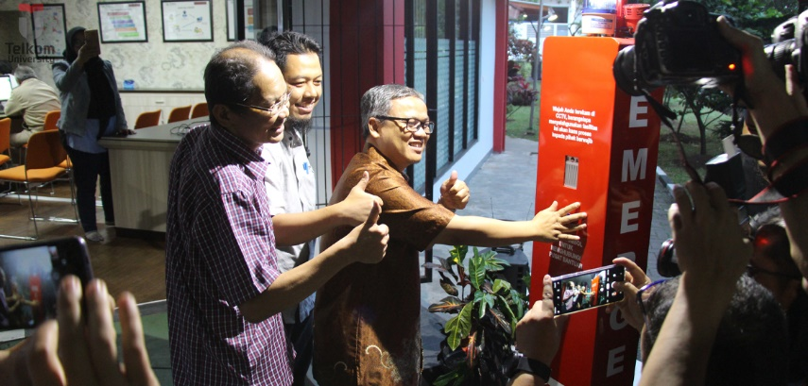
Best Practice – Digital Campus Safety
Sudah Terpasang 115 kamera pengawas (CCTV) & 5 Titik Panic Button

Slide 17
Best Practice –Education 4.0

Slide 18
Best Practice – E-Learning
Learning Management System
Dashboard Content
Pembuatan Content Video & Non-Video:
637 Mata Kuliah (992 MK Target)
9 Studio
Rp. 30 M Total Anggaran
Center for E – Learning and Open Education

Slide 19
Kurikulum 4.0
ICT
Data
Human
Finance for Non-Fin. Student
Computing for Non-Computing Student
Blanded Learning
Augmented Reality &
Virtual Reality

Slide 20
New Paradigm
Creativity & Innovation
Customer Experience
Services Excellence
Regulatory Compliance

Slide 21
Seyogyanya, jadilah seperti Lebah yang senantiasa memberikan manfaat bagi lingkungan
tanpa merusak kesetimbangan
LLDIKTI Wilayah 4
HATUR NUHUN
@kangady
@Adiwijaya_Tel_U

