Slide 1
Internet of Things: Challenges to STRATEGIC MANAGEMENT
JOSEPH G. REFUGIO, FBE, CHP, DM-EM
Dean, College of Business Education
St. Vincent’s College Incorporated
Dipolog City, Philippines

Slide 3
is considered to be a “disruptive technology"

Slide 4
This means that it disrupts the status quo in a competitive industry

Slide 5
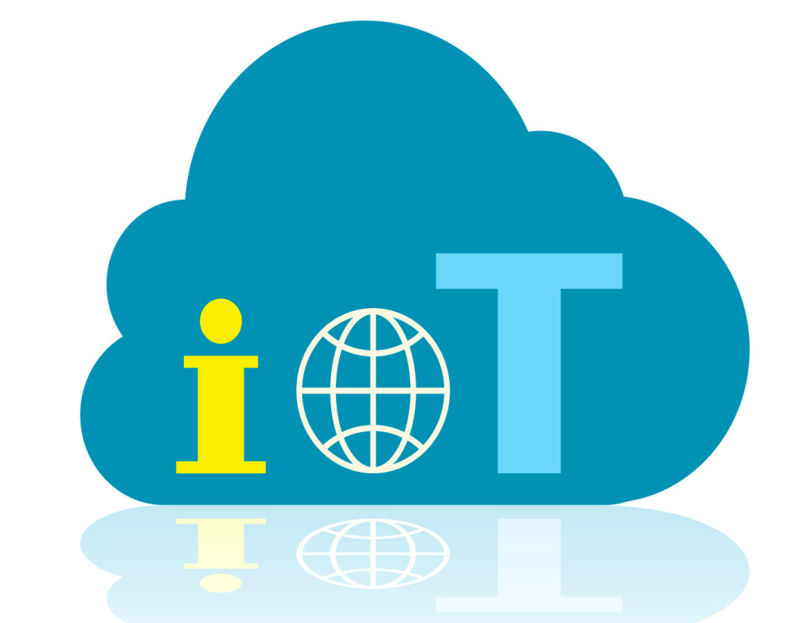
WHAT IS

Slide 6
Is THE NETWORK OF PHYSICAL OBJECTS or “THINGS” embedded with electronics, software, sensors, and network connectivity, which enables these objects to collect and exchange data

Slide 8
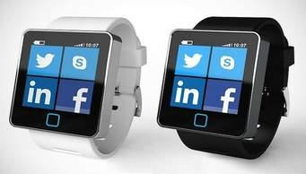
Smart Watches

Slide 10
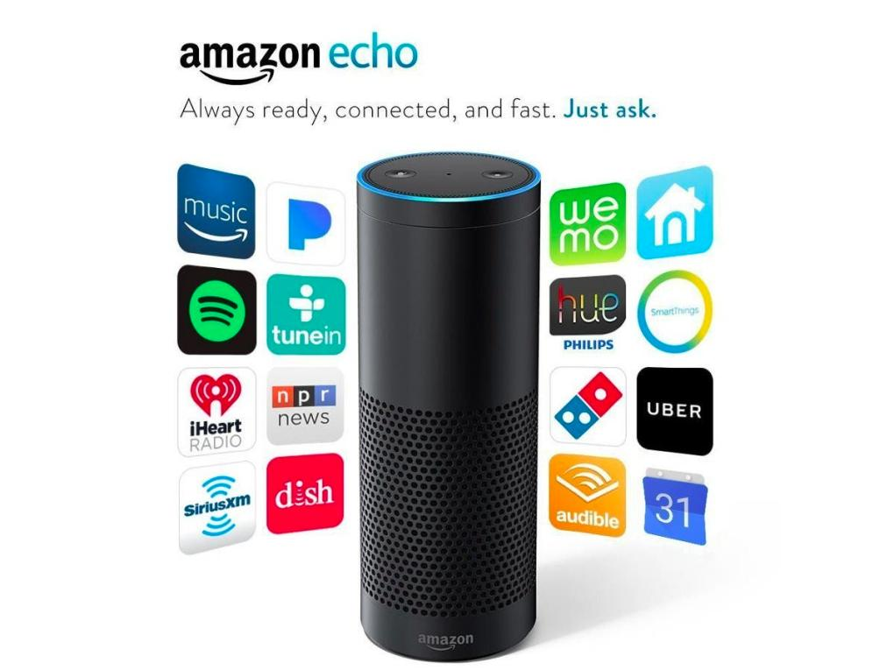
Smart Speakers

Slide 11
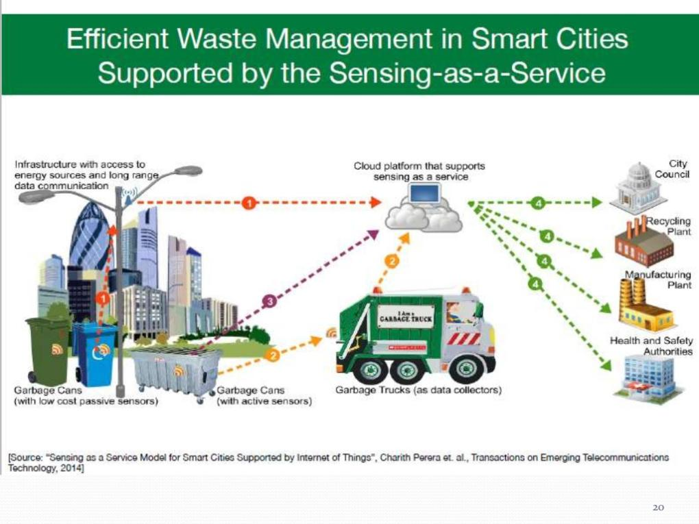

Slide 13
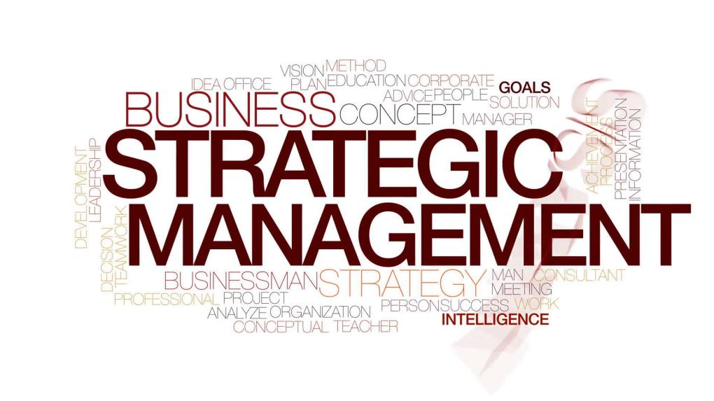

Slide 21
Starbucks wants to use the Internet of Things to improve business efficiency and the quality of their drinks.

Slide 22
Starbucks system called CloverNet, track customer preferences, update recipes digitally and self-monitor performance so problems can be flagged up…

Slide 24
“The Internet of Things (IoT) is the point of connection between products and the results they deliver—it’s where products become software”

Slide 25
IoT is not a new business trend. It’s the new way of business.

Slide 26
As Benjamin Franklin once cautioned: “By failing to prepare, you are preparing to fail.”

Slide 27
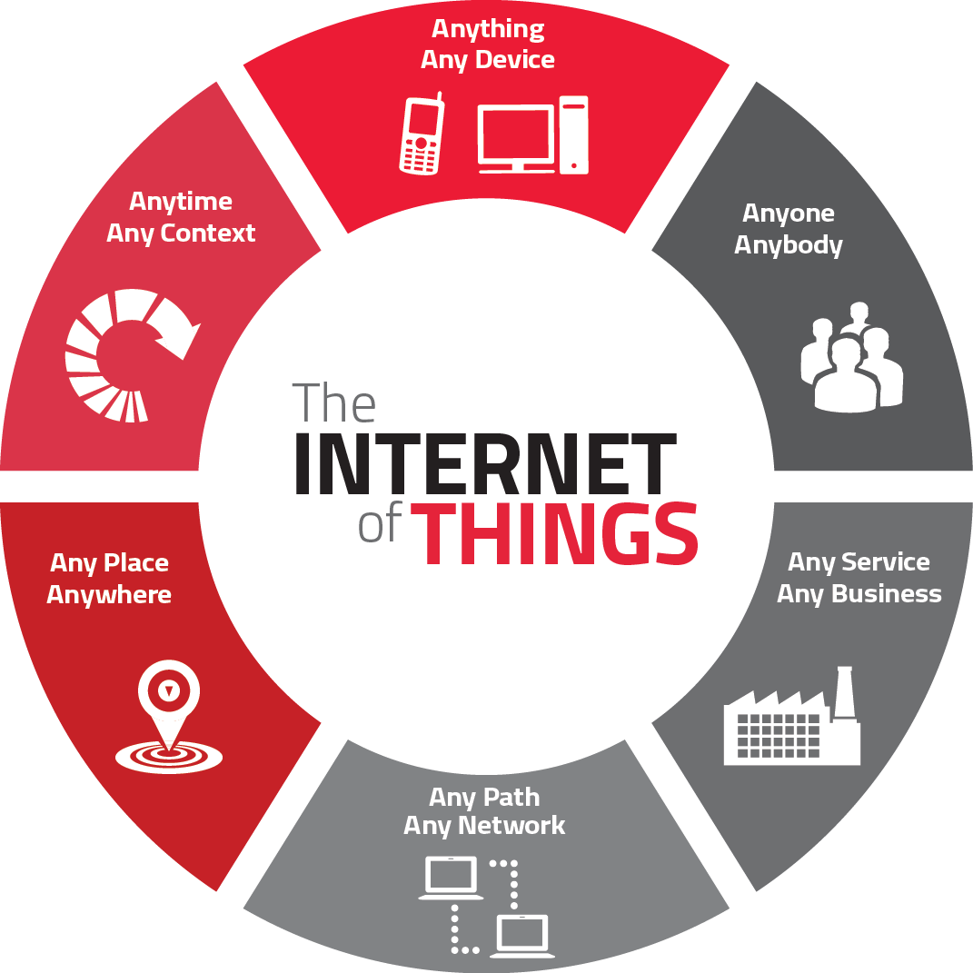
BUSINESSES must plan today for the emerging risks of tomorrow

Slide 28
Strategic management includes strategic planning, implementation and review/control of the strategy of an organization.

Slide 29
Gartner shortlisted the 10 most strategic IoT technologies and trends that will enable new revenue streams and business models, as well as new experiences and relationships:

Slide 30
TREND NO. 1

Slide 31
STRATEGY:
…must build an organization with the tools and skills to exploit AI in their IoT strategy.

Slide 32
TREND NO. 2
Social, Legal & Ethical of IoT

Slide 33
STRATEGY
Organizations must, therefore, educate themselves and their staff in this area, and consider forming groups, such as ethics councils, to review corporate strategy. Managers should also consider having key algorithms and AI systems reviewed by external consultancies to identify potential bias.”

Slide 34
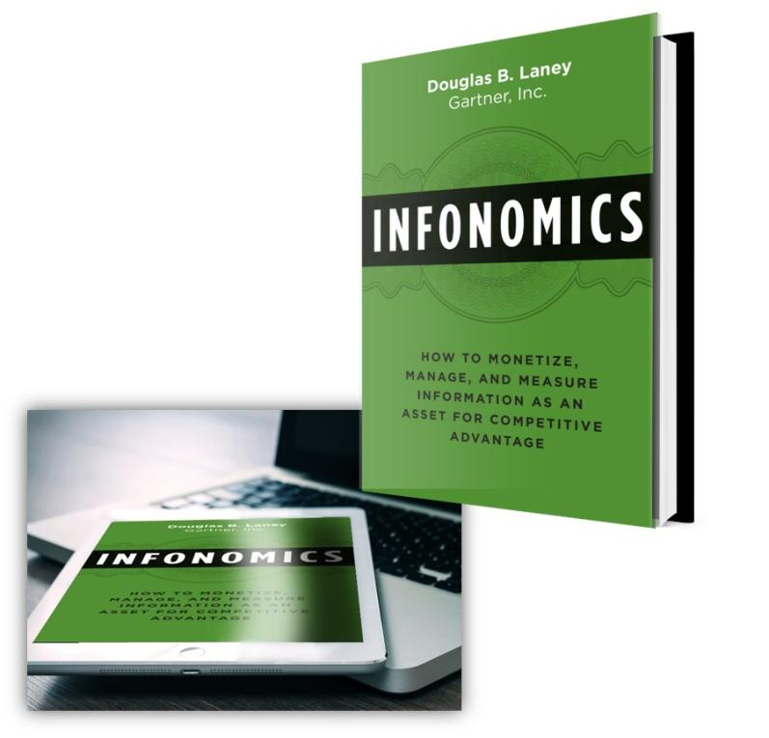
TREND NO. 3
& DATA BROKING

Slide 35
STRATEGY
…must educate their organizations on the risks and opportunities related to data broking in order to set the IT policies required in this area and to advise other parts of the organization.

Slide 36
TREND NO. 4
The Shift from Intelligent Edge to Intelligent Mesh

Slide 37
STRATEGY
Organizations must prepare for mesh architectures’ impact on IT infrastructure, skills and sourcing.

Slide 38
TREND No. 5
IoT

Slide 39
STRATEGY
Organization must take on the role of educating their organizations on governance issues and in some cases invest in staff and technologies to tackle governance.

Slide 40
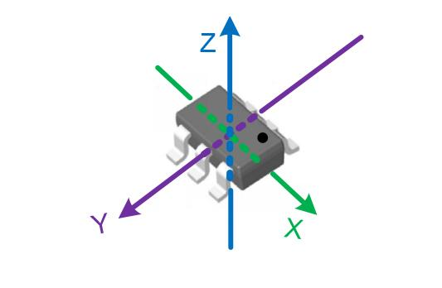
TREND NO. 6
SENSOR INNOVATION

Slide 41
STRATEGY
Organizations should ensure their teams are monitoring sensor innovations to identify those that might assist new opportunities and business innovation.

Slide 42
TREND NO. 5
TRUSTED HARDWARE AND OPERATING SYSTEM

Slide 43
STRATEGY
Organizations are advised to collaborate with chief information security officers to ensure the right staff are involved in reviewing any decisions that involve purchasing IoT devices and embedded operating systems.”

Slide 44
TREND NO. 8
Novel IoT User Experiences

Slide 45
STRATEGY
Organizations’ UX designers will be required to use new technologies and adopt new perspectives if they want to create a superior UX that reduces friction, locks in users, and encourages usage and retention

Slide 46
TREND NO. 9
SELICON CHIP INNOVATION

Slide 47
STRATEGY
Organizations are advised to take note of this trend as silicon chips enabling functions such as embedded AI will in turn enable organizations to create highly innovative products and services.

Slide 48
TREND NO. 10
New Wireless Networking Technologies for IoT

Slide 49
STRATEGY
No single networking technology optimizes all of these and new IoT networking technologies will provide organizations with additional choice and flexibility. In particular they should explore 5G, the forthcoming generation of low earth orbit satellites, and backscatter networks.

