Slide 1
The Emergence of Digital Millennials in Indonesia
Presented By:
Santy Christinawati, S.S,. M.Hum
October 2019

Slide 2
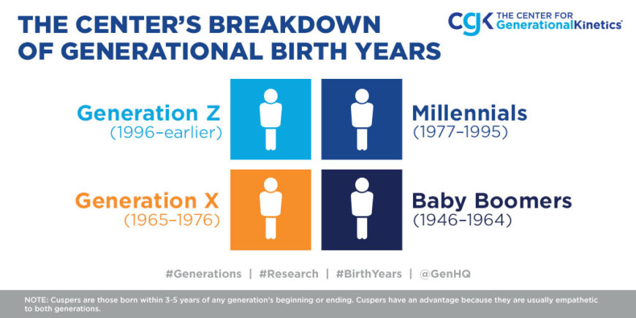

Slide 3
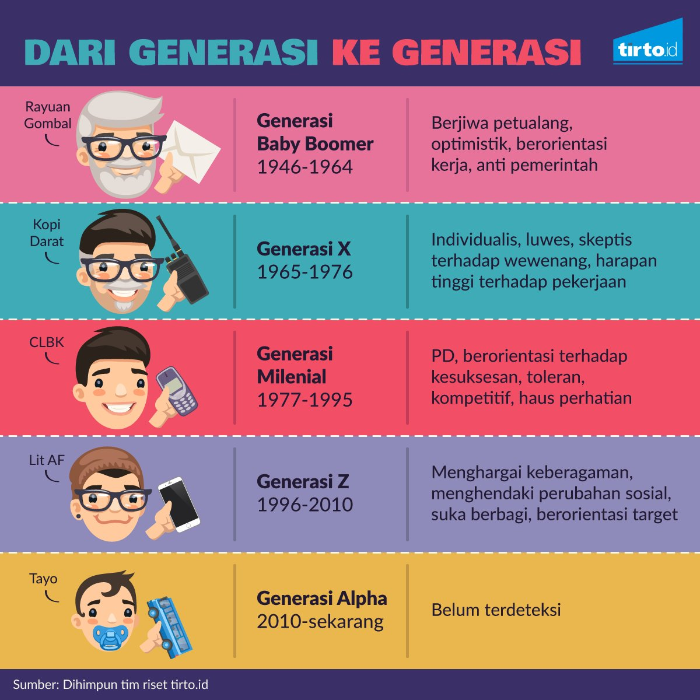
Which generation are you?

Slide 4
Gen Y and Gen Z = Millennials
The generations are now leaders in companies with different perspectives and different way of thinking and leadership.
They grew up and began their career in a time when:
Almost every home had an internet connection
Terrorist attacks
Global warming
The explosive growth in online companies such as Google, FB, IG, OVO, etc
A revolution in the way we work including acceptance of flex-time, work from home, and freelancing

Slide 5
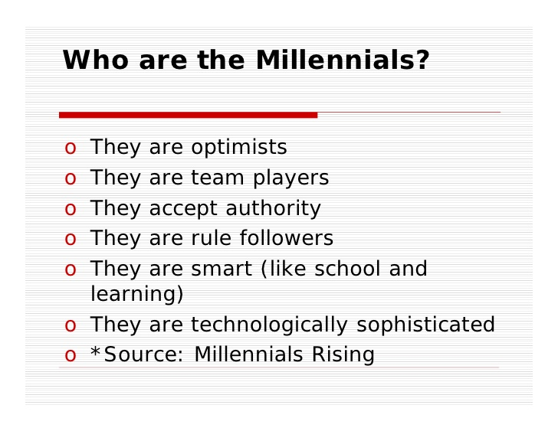

Slide 6
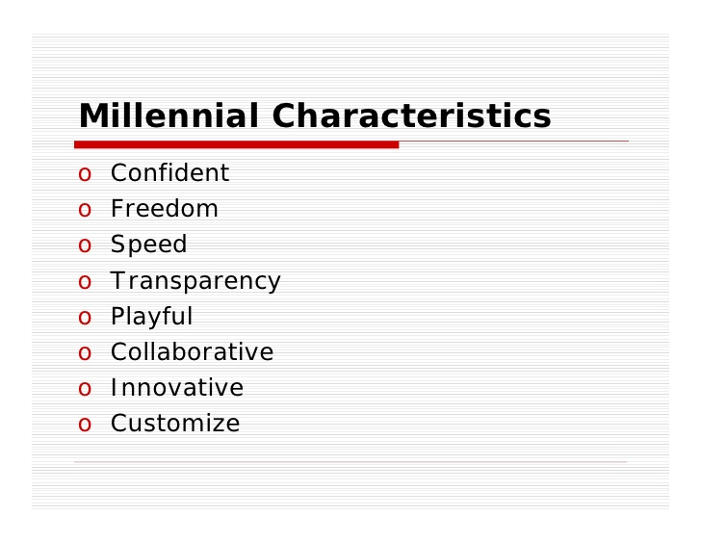

Slide 7
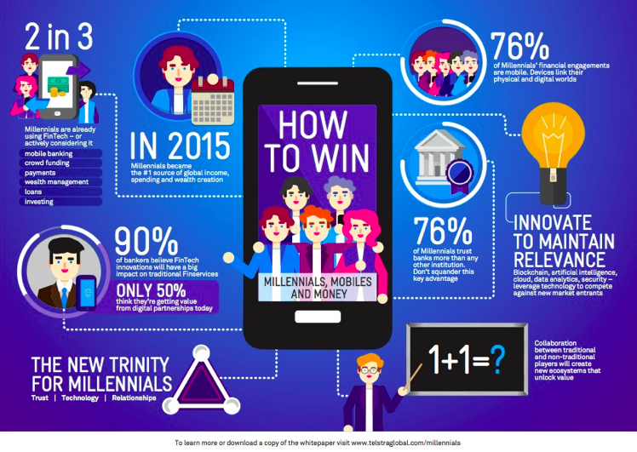
Millennials and IoT

Slide 8
Millennials and IoT
Streaming native
E-Commerce native
Democracy native
Technology native

Slide 9
Millennials + IoT = New Indonesia
Millennials as a medium of change
Technology as a subject of change
The social media existence is very effective to collect the aspiration that can bring new pattern in Indonesia.

Slide 10
BRAVE (George Bradt)
“Don’t even try to manage millennials, lead them”
1. Behaviors (What impacts?)
2. Relationship (How to connect-Communication)
3. Attitude (How to win-Strategy)
4. Values (What matters and why – Purpose)
5. Environment (Where to play-Context)

Slide 11
Indonesia Millennials Leaders
Indonesia has 63.4 million millennials.
The millennials belong to the age group of 20 to 35 years.
Millennials constitute some 24 percent of Indonesia`s population, and they are
the future leaders of the Indonesian nation.
the millennial generation plays a vital role in industry 4.0, especially considering that
Indonesia will also enjoy a demographic bonus period until 2030.
This means as many as 130 million people of the productive age group can seize new opportunities
to develop business in the digital era.

Slide 12
Millennials Challenges
Actualization, self development for adaptation.
Productivity, millennials mostly concern for consuming.
But millennials can be the most wealthy generation in the future, WHY?
They work because of passion
They work as entrepreneurs
They create start up
They are investors

Slide 13
The Successful Indonesian Millennials
Ahmad Zaki, CEO Bukalapak, 1986 (USD 110 juta , 1,5 T)
Ugine dan Ferry, Puyo Silky Dessert, 2000 ( 1 Milyar/bln)
Ferry Unardi , CEO Traveloka, 1988 (145 juta Dollar)
Nadiem Makarim, CEO Gojek, 1984 (1,4 T)
William Tanuwijaya, CEO Tokopedia, 1981 (1,8T)

Slide 14
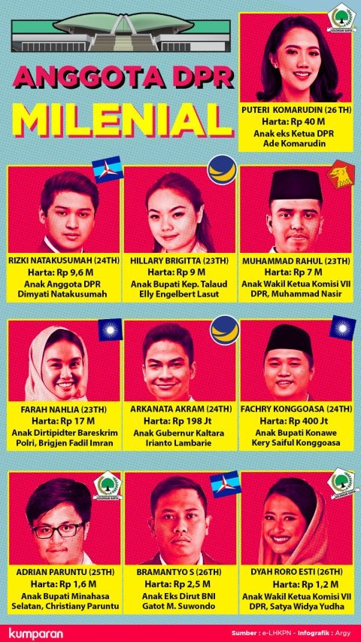

Slide 15

          “Be yourself- it’s the best that you can do”

